Slide 1
Data Science Springboard Professionals Program
Day 6
Data Analysis III: Multivariate analysis
Drs Cericia Martinez and Guillaume Rongier
CSIRO

Slide 3

Schedule
Start | End | Agenda
08:30 | 08:45 | Q&A, Issues & Announcements
08:45 | 10:00 | More Regression
10:00 | 10:30 | Morning Tea
10:30 | 12:00 | Dimensionality Reduction
12:00 | 13:00 | Lunch
13:00 | 14:30 | Clustering and High-D Regression
14:30 | 15:00 | Afternoon Tea
15:00 | 15:30 | Partial Least Squares
15:30 | 16:30 | Apply to your own Problem
16:30 | 16:45 | Closeout
Cericia Martinez & Guillaume Rongier | CSIRO

Slide 4
Q&A, Issues & Announcements
Before we Get Started
Resources on SkillSocial
Reflections, questions and Issues: Gitter (also on mobile/desktop if you like)
Jargon Demystifying Library & Free Whiteboard: A place to throw all the terms and phrases which don’t make immediate sense https://tinyurl.com/EndDataJargon
Cericia Martinez & Guillaume Rongier | CSIRO

Slide 5
Day 6
Perform multivariate Exploratory Data Analysis (EDA).
Analyse central tendency, dispersion and correlations.
Practice unsupervised learning: principal component analysis (PCA) and clustering.
Understand the differences between univariate and multivariate data and apply multivariate techniques and EDA.
Understand the basis of dimensionality reduction.
Apply k-means clustering.
Critique whether a correlation is spurious.
Identify if the process used in the activities is reproducible.
Understand the impact of missing data and recall practical solutions to work with incomplete data sets.

Slide 6
More Regression

Slide 7
Refresher from last time
Open am1_more_regression.ipynb and go through Exercise 1
Feel free to work through this individually or in pairs
We will keep time according to pair programming (10 minutes each)
Use the next 20 minutes to complete the exercise
Then we will move onto multivariate data

Slide 8
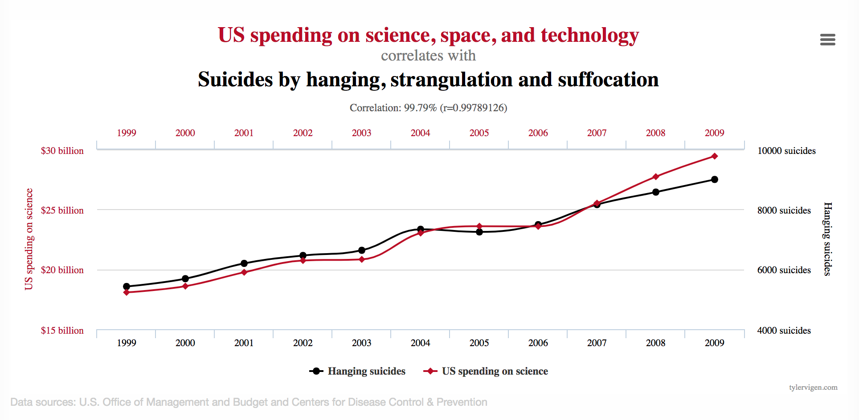
From univariate to multivariate data
To regress or not to regress
We see correlation
We can build a model to express this relationship
But should we?
Spurious correlation from tylervigen.com
Cericia Martinez & Guillaume Rongier | CSIRO

Slide 9
Missing data
In some cases, we have missing data that will actually bias our regression results. If possible, we would like to try and account for this or replace the missing data.
Replacing missing data is called imputation.
There are multiple ways to do this ranging from interpolation, substitution, and regression
Each method has drawbacks and the technique used should be appropriate for the type of data
Cericia Martinez & Guillaume Rongier | CSIRO

Slide 10
Multivariate regression

Slide 11
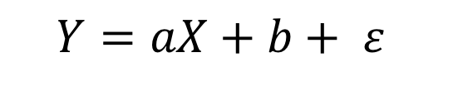
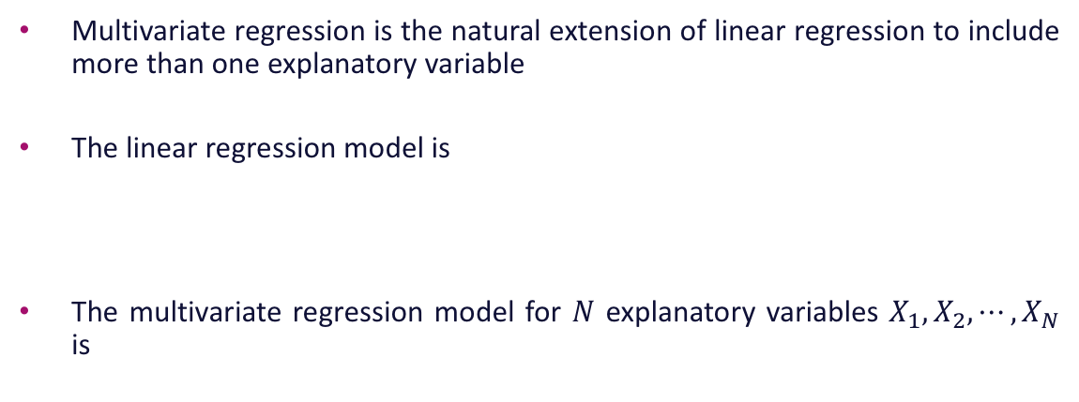
Multivariate regression
Multivariate regression is the natural extension of linear regression to include more than one explanatory variable
The linear regression model is
The multivariate regression model for $N$ explanatory variables $X_{1},X_{2}, ⋯,X_{N}$ is
$$Y=aX+b+ ε$$
$$Y=β_{1}X_{1}+β_{2}X_{2}+⋯+β_{N}X_{N}+β_{0}+ε$$
Oscar Rondon

Slide 12
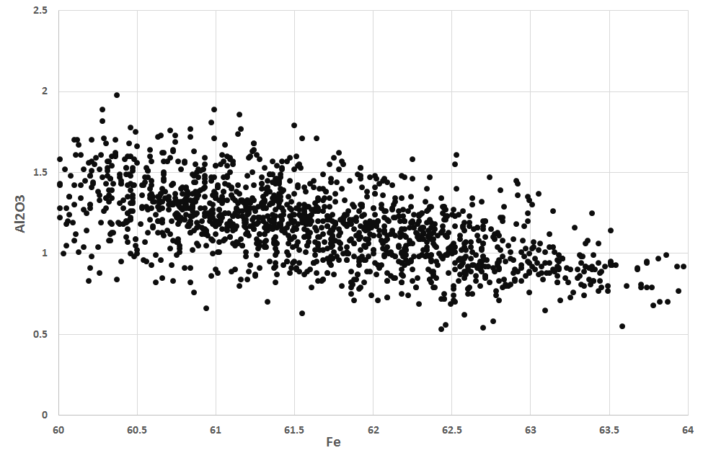
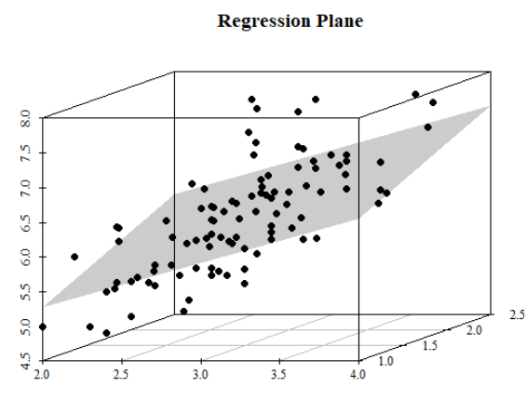
Linear vs. multivariate regression
Linear Regression
Multivariate Regression
The linear regression model fits a line through the points
The multivariate regression model fits a plane through the points
Oscar Rondon

Slide 13
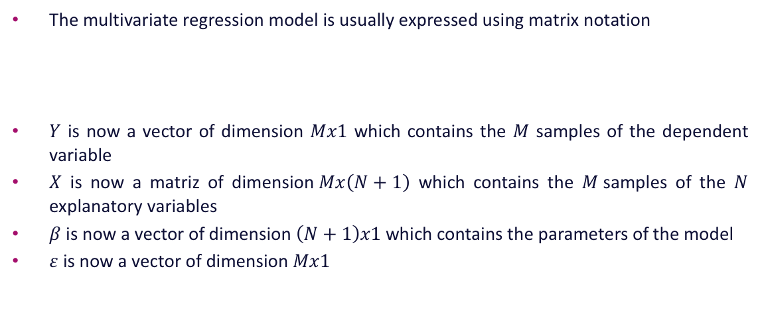
Multivariate regression
Notation
The multivariate regression model is usually expressed using matrix notation
$Y$ is now a vector of dimension $Mx1$ which contains the $M$ samples of the dependent variable
$X$ is now a matriz of dimension$Mx\left(N+1\right)$ which contains the $M$samples of the $N$ explanatory variables
$β$ is now a vector of dimension $\left(N+1\right)x1$ which contains the parameters of the model
$ε$ is now a vector of dimension $Mx1$
$$Y=Xβ+ε$$
Oscar Rondon

Slide 14
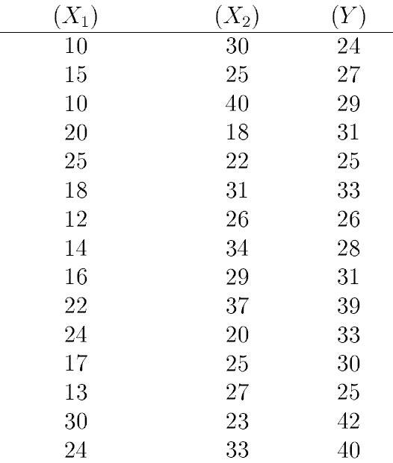
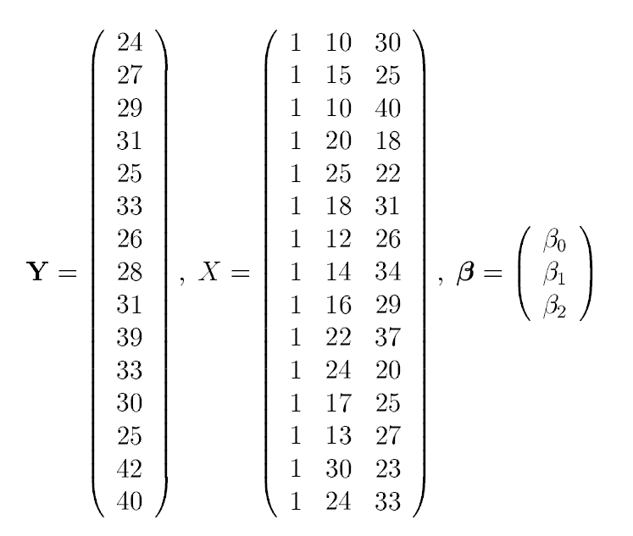
Multivariate regression
For instance, an Excel table with samples for two explanatory attributes and one dependent variable
Care should be exercised when entering the data into the program to run the multivariate regression model
15x1
15x(2+1)
(2+1)x1
Oscar Rondon

Slide 15
Multivariate regression
Similar to the linear regression model, the assumptions are made on the error component
These assumptions are similar but in a multivariate setting
The error has multivariate Gaussian distribution with mean zero and constant variance
Homoscedasticity and no bias
The error is independent of all explanatory variables and the dependent variable
Scatterplot of the error with all explanatory variables should not show any clear pattern
Oscar Rondon

Slide 16
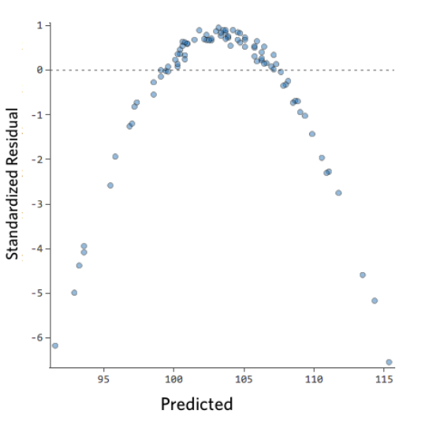
Multivariate regression
Some patterns are indicative that a transformation in one explanatory variable is needed
Worth considering a power transformation in the multivariate regression model, e.g.
$$Y=β_{1}X_{1}^{2}+β_{2}X_{2}+⋯+β_{N}X_{N}+β_{0}+ε$$
Oscar Rondon

Slide 17
Validating a multivariate regression model

Slide 18
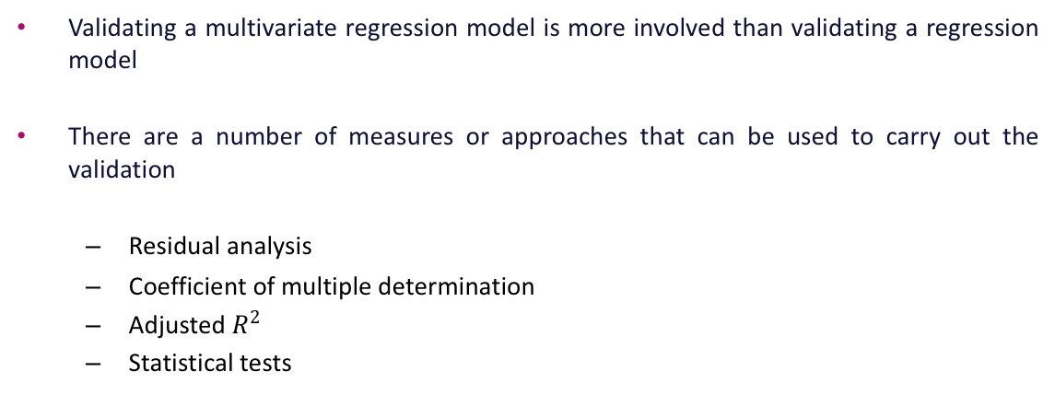
Validating a multivariate regression model
Validating a multivariate regression model is more involved than validating a regression model
There are a number of measures or approaches that can be used to carry out the validation
Residual analysis
Coefficient of multiple determination
Adjusted $R^{2}$
Statistical tests
Oscar Rondon

Slide 19
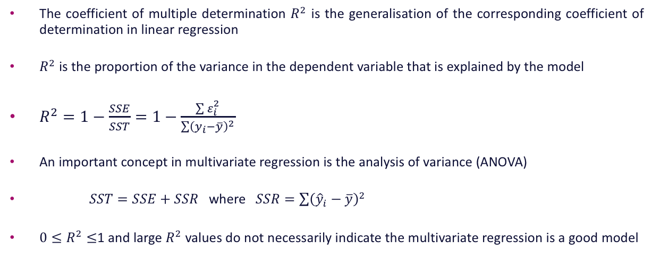
Validating a multivariate regression model
The coefficient of multiple determination $R^{2}$ is the generalisation of the corresponding coefficient of determination in linear regression
$R^{2}$ is the proportion of the variance in the dependent variable that is explained by the model
$R^{2}=1−\frac{SSE}{SST}=1−\frac{\sum{ε_{i}^{2}}}{\sum{{\left(y_{i}−\overline{y}\right)}^{2}}}$
An important concept in multivariate regression is the analysis of variance (ANOVA)
$SST=SSE+SSR$ where $SSR=\sum{{\left({\hat{y}}_{i}−\overline{y}\right)}^{2}}$
${0≤R}^{2}≤$1 and large $R^{2}$ values do not necessarily indicate the multivariate regression is a good model
Oscar Rondon

Slide 20
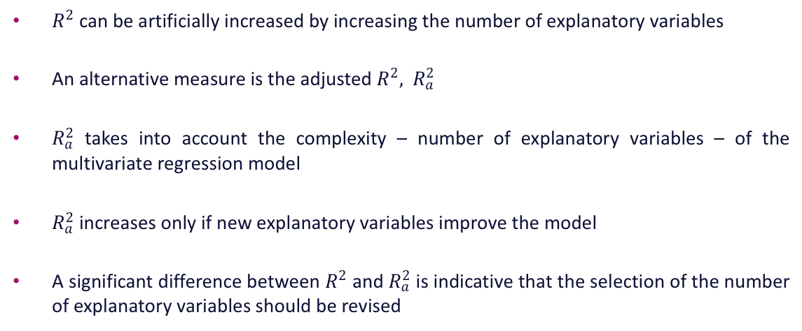
Validating a multivariate regression model
$R^{2}$ can be artificially increased by increasing the number of explanatory variables
An alternative measure is the adjusted $R^{2},$ $R_{a}^{2}$
$R_{a}^{2}$ takes into account the complexity – number of explanatory variables – of the multivariate regression model
$R_{a}^{2}$ increases only if new explanatory variables improve the model
A significant difference between $R^{2}$ and $R_{a}^{2}$ is indicative that the selection of the number of explanatory variables should be revised
Oscar Rondon

Slide 21
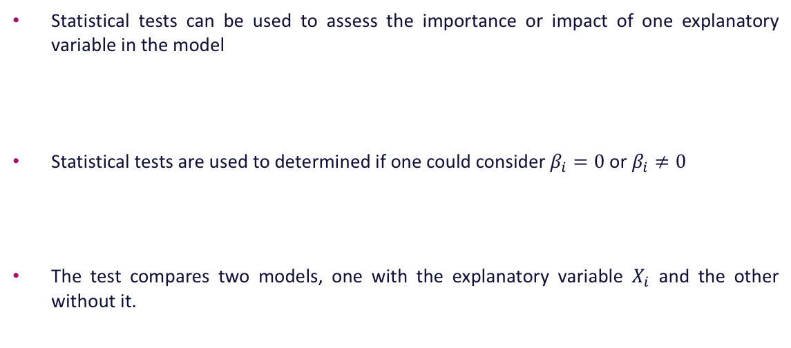
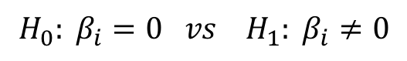
Validating a multivariate regression model
Statistical tests can be used to assess the importance or impact of one explanatory variable in the model
Statistical tests are used to determined if one could consider $β_{i}=0$ or $β_{i}≠0$
The test compares two models, one with the explanatory variable $X_{i}$ and the other without it.
$$Y=β_{1}X_{1}+β_{2}X_{2}+⋯+β_{N}X_{N}+β_{0}+ε$$
$${H_{0}: β}_{i}=0 vs{{ H}_{1}: β}_{i}≠0$$
Oscar Rondon

Slide 22
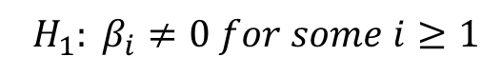
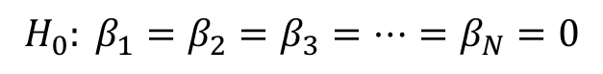
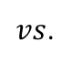
Validating a multivariate regression model
The F-test is used to test the overall significance of the multivariate regression model
The F-test compares the multivariate regression model with a model with no explanatory variables
A decision can be made by analysing the statistical results
$${H_{0}: β}_{1}=β_{2}=β_{3}=⋯=β_{N}=0$$
$vs$.
$${{ H}_{1}: β}_{i}≠0 for some i≥1$$
Oscar Rondon

Slide 23
Analysing the statistical results

Slide 24
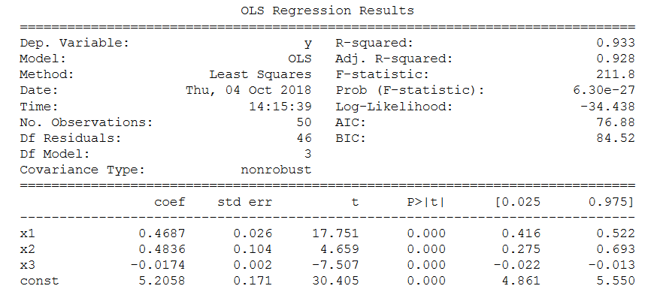
Analysing the statistical results
Most programs provide a set of statistical results to diagnose the multivariate regression model
Number of explanatory variables
Oscar Rondon
coefficients
$$Y=0.4687X_{1}+0.4836X_{2}−0.0174X_{3}+5.2058$$

Slide 25
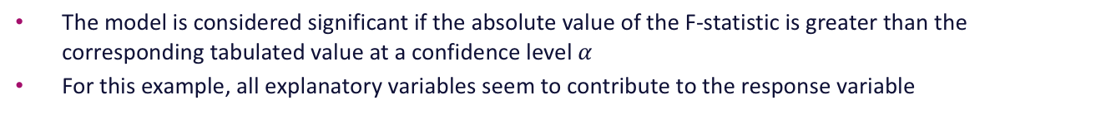
Analysing the statistical results
The model is considered significant if the absolute value of the F-statistic is greater than the corresponding tabulated value at a confidence level $α$
For this example, all explanatory variables seem to contribute to the response variable
Oscar Rondon

Slide 26
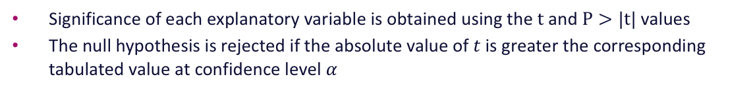
Analysing the statistical results
Significance of each explanatory variable is obtained using the $t$ and $P>|t|$values
The null hypothesis is rejected if the absolute value of $t$ is greater the corresponding tabulated value at confidence level $α$
Oscar Rondon

Slide 27
Analysing the statistical results
AIC and BIC stand for Akaike’s and Bayesian information criteria respectively
The smaller the AIC and the BIC values the better the model
Useful when comparing two different models
Oscar Rondon

Slide 28
Exercise 2: Basis Regression using templates
Spend the rest of the time working through Exercise 2 in am1_more_regression.ipynb
Cericia Martinez & Guillaume Rongier | CSIRO

Slide 29
Dimensionality Reduction

Slide 30
Variable selection as dimension reduction
Selecting the best set of variables to build a model leads to many benefits:
Better predictions
Better model interpretability and explainability
Lower computational cost of training
Less impact from the curse of dimensionality
Cericia Martinez & Guillaume Rongier | CSIRO

Slide 31
Variable selection as dimension reduction
What could be an easy way to select the most useful variables?
Cericia Martinez & Guillaume Rongier | CSIRO

Slide 32
Dimensionality reduction
scikit-learn.org/stable/tutorial/machine_learning_map/index.html
Cericia Martinez & Guillaume Rongier | CSIRO

Slide 33
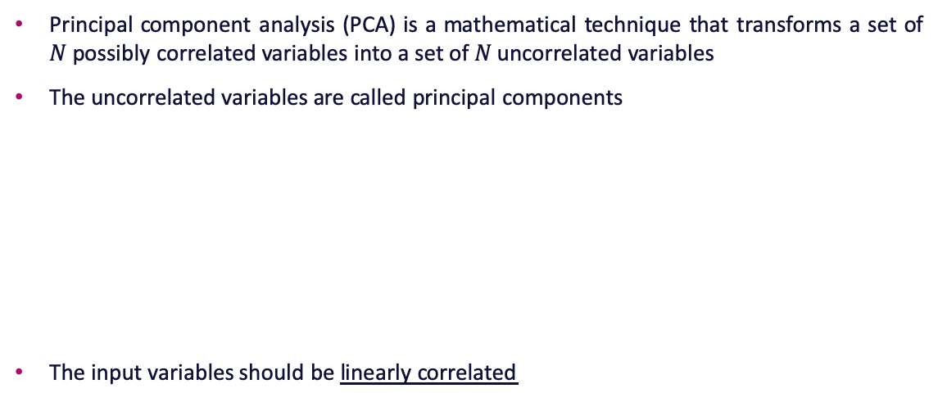
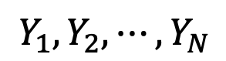
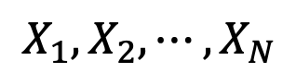
An Introduction to Principal Component Analysis
Principal component analysis (PCA) is a mathematical technique that transforms a set of $N$possibly correlated variables into a set of $N$ uncorrelated variables
The uncorrelated variables are called principal components
The input variables should be linearly correlated
$$X_{1},X_{2}, ⋯,X_{N}$$
$$Y_{1},Y_{2}, ⋯,Y_{N}$$
Correlated variables
Principal components
Oscar Rondon

Slide 34
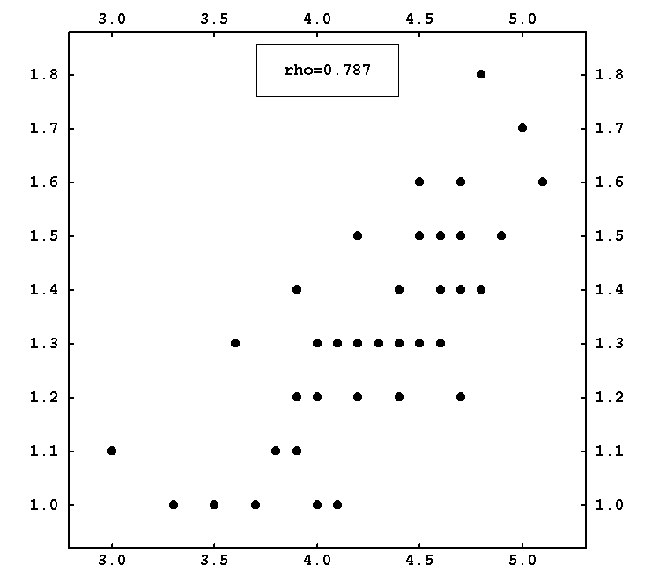
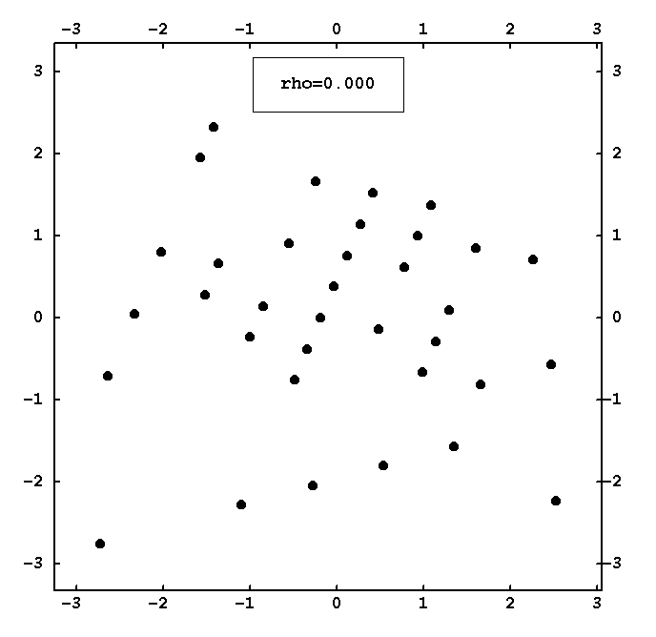
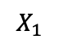
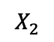
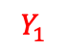
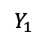
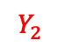
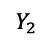
An Introduction to Principal Component Analysis
$$Y_{1}$$
$$X_{2}$$
$$Y_{2}$$
$$Y_{2}$$
$$X_{1}$$
Note that PCA variables have different values compared to the input variables
Oscar Rondon
$$Y_{1}$$

Slide 35
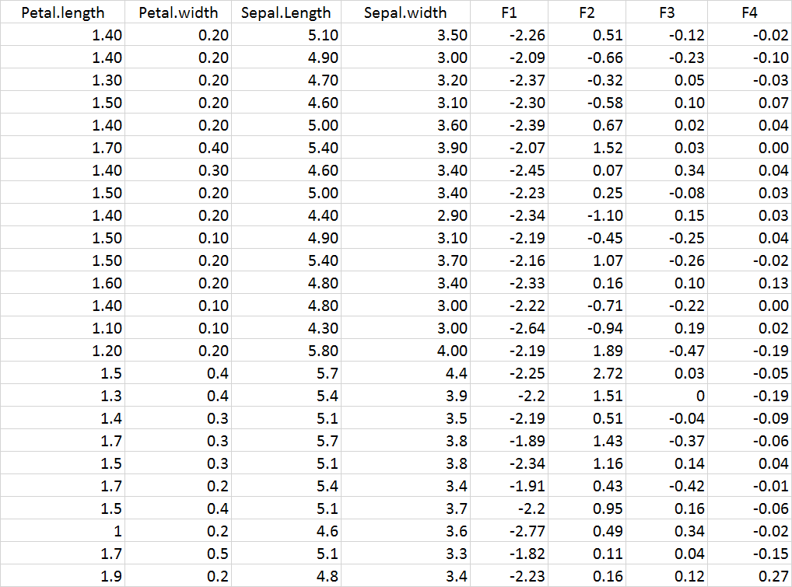
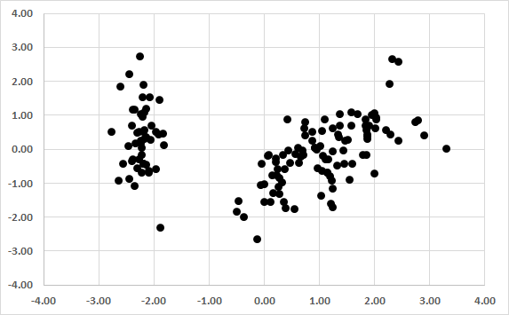
An Introduction to Principal Component Analysis
Excel table with input and PCA variables
Oscar Rondon

Slide 36
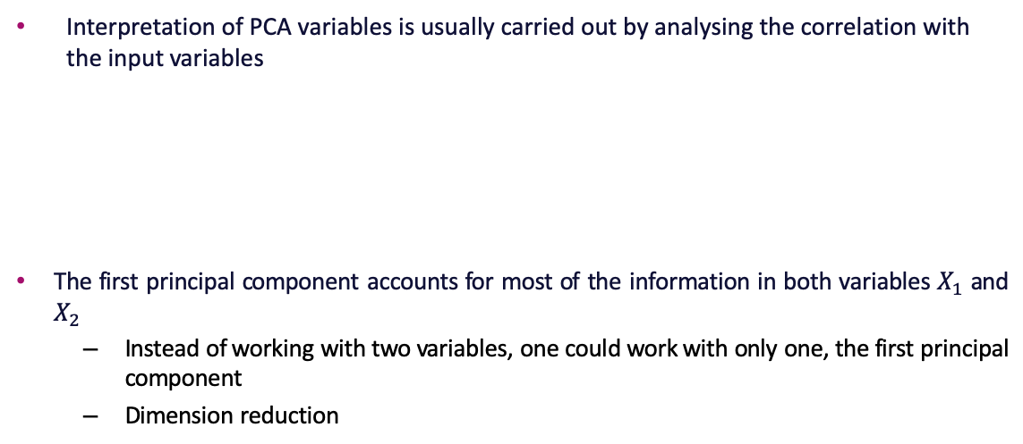
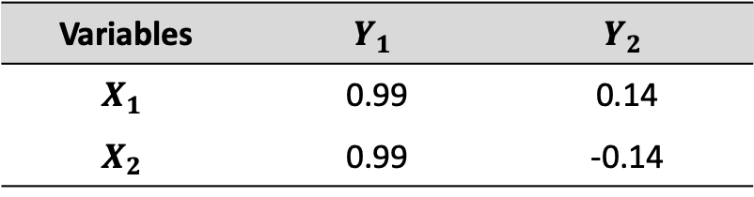
An Introduction to Principal Component Analysis
Interpretation of PCA variables is usually carried out by analysing the correlation with the input variables
The first principal component accounts for most of the information in both variables $X_{1}$ and $X_{2}$
Instead of working with two variables, one could work with only one, the first principal component
Dimension reduction
Variables | $$Y_{1}$$ | $$Y_{2}$$
$$X_{1}$$ | 0.99 | 0.14
$$X_{2}$$ | 0.99 | -0.14
Oscar Rondon

Slide 37
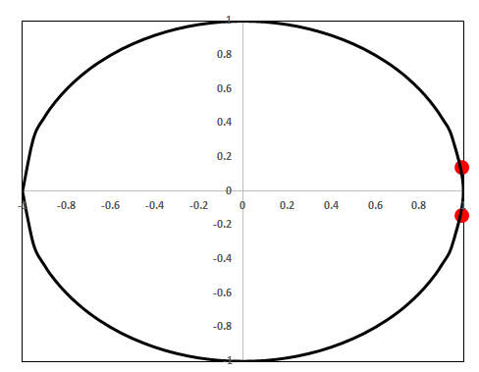
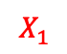
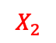

An Introduction to Principal Component Analysis
In practice, the circle of correlation is commonly used when several variable are being analysed
Variables | $$Y_{1}$$ | $$Y_{2}$$
$$X_{1}$$ | 0.99 | 0.14
$$X_{2}$$ | 0.99 | -0.14
$$X_{1}$$
Factor loadings
$$X_{2}$$
Oscar Rondon

Slide 38
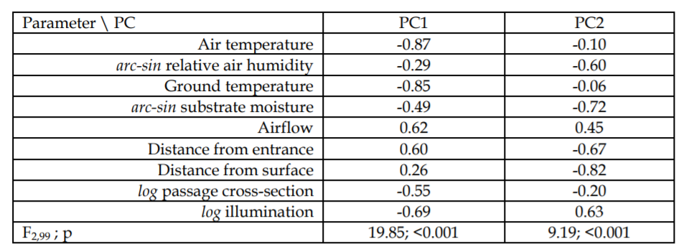
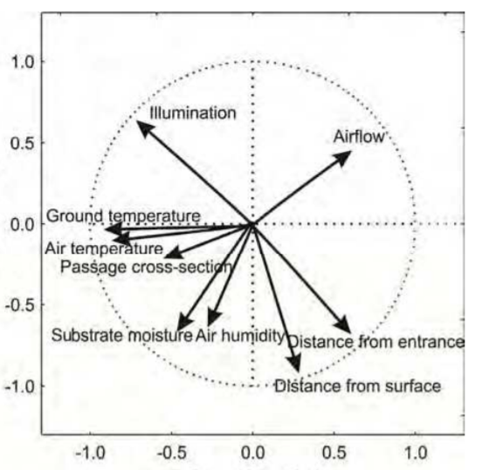
An Introduction to Principal Component Analysis
Example: Environmental data with nine input variables
What can we conclude from the circle of correlation?
Oscar Rondon

Slide 39
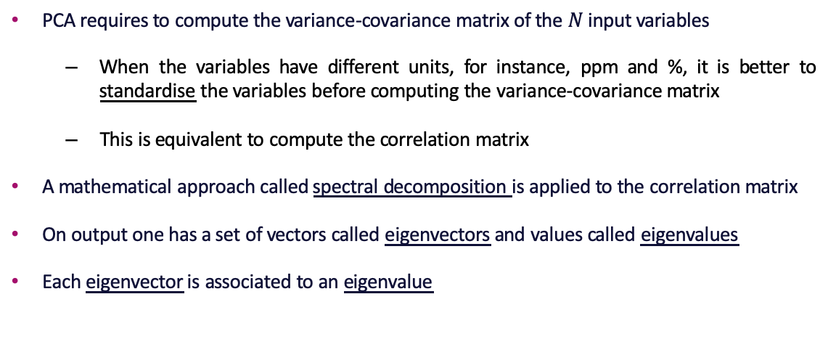
PCA Theory – A Gentle Introduction
PCA requires to compute the variance-covariance matrix of the $N$ input variables
When the variables have different units, for instance, ppm and %, it is better to standardise the variables before computing the variance-covariance matrix
This is equivalent to compute the correlation matrix
A mathematical approach called spectral decomposition is applied to the correlation matrix
On output one has a set of vectors called eigenvectors and values called eigenvalues
Each eigenvector is associated to an eigenvalue
Oscar Rondon

Slide 40
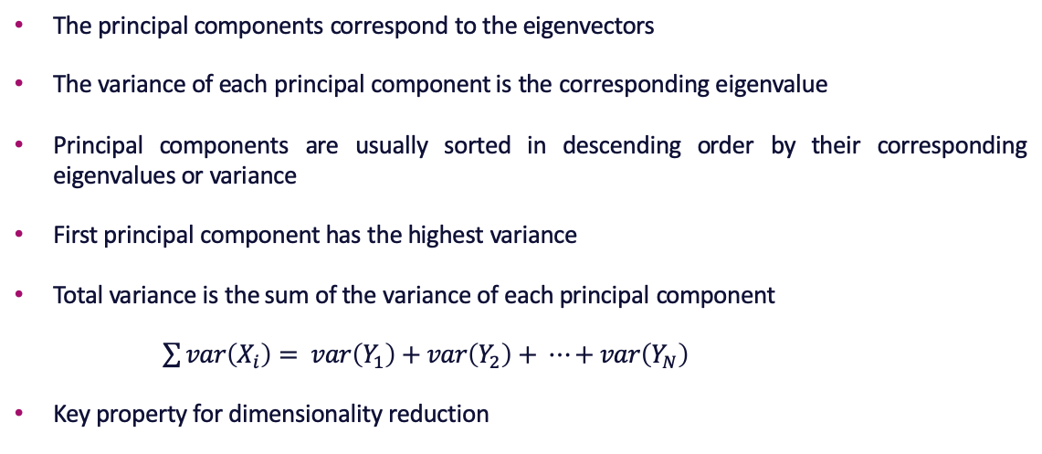
PCA Theory – A Gentle Introduction
The principal components correspond to the eigenvectors
The variance of each principal component is the corresponding eigenvalue
Principal components are usually sorted in descending order by their corresponding eigenvalues or variance
First principal component has the highest variance
Total variance is the sum of the variance of each principal component
$\sum{var\left(X_{i}\right)}= var\left(Y_{1}\right)+var\left(Y_{2}\right)+ ⋯+var\left(Y_{N}\right)$
Key property for dimensionality reduction
Oscar Rondon

Slide 41
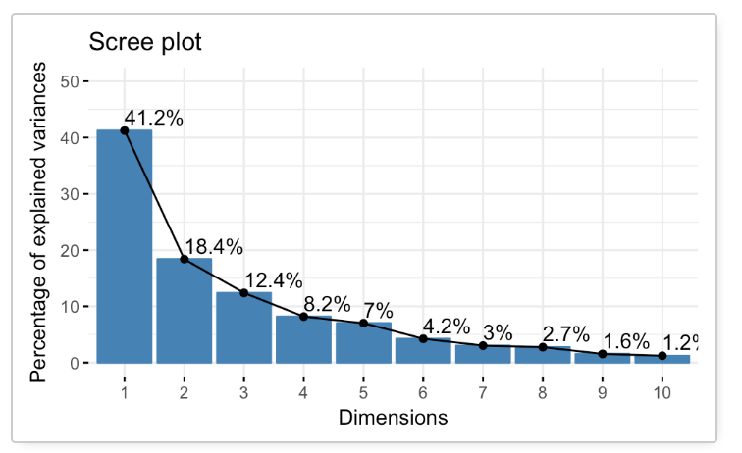
PCA Theory – A Gentle Introduction
How to choose the number of principal components to retain?
The scree plot shows the fraction of the total variance in the data that is explained by each principal component
Oscar Rondon

Slide 42
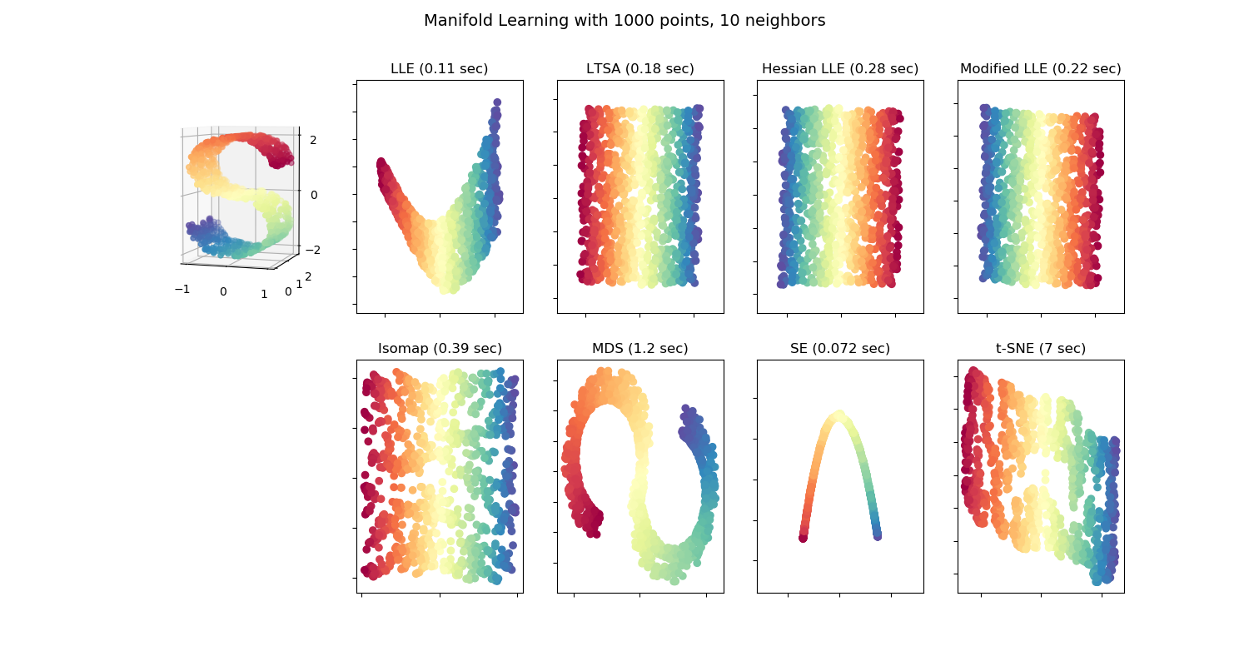
A short overview of manifold learning
Cericia Martinez & Guillaume Rongier | CSIRO
Source: scikit-learn.org/stable/modules/manifold.html

Slide 43
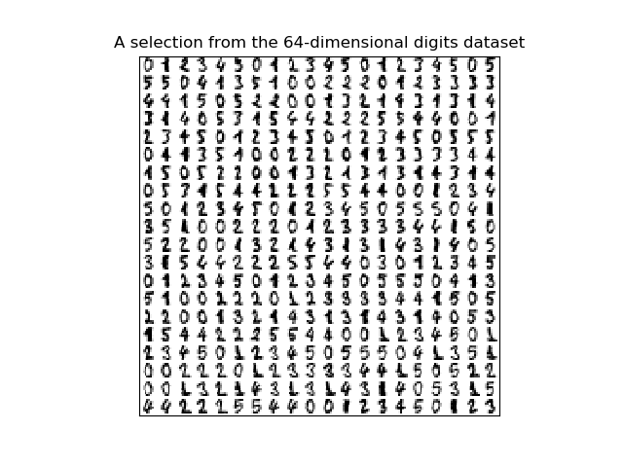
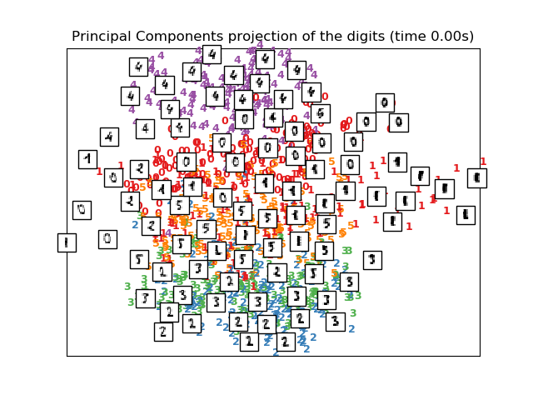
About t-distributed Stochastic Neighbor Embedding (t-SNE)
t-SNE has become incredibly popular for its impressive ability to manage thousands of dimensions
Cericia Martinez & Guillaume Rongier | CSIRO
Source: scikit-learn.org/stable/auto_examples/manifold/plot_lle_digits.html#
sphx-glr-auto-examples-manifold-plot-lle-digits-py

Slide 44
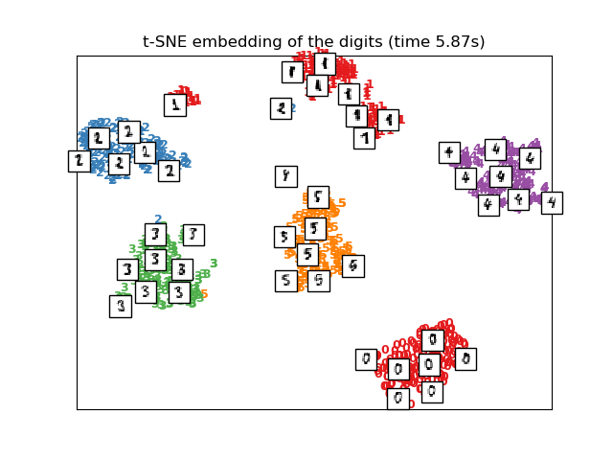
About t-distributed Stochastic Neighbor Embedding (t-SNE)
t-SNE has become incredibly popular for its impressive ability to manage thousands of dimensions
Cericia Martinez & Guillaume Rongier | CSIRO
Source: scikit-learn.org/stable/auto_examples/manifold/plot_lle_digits.html#
sphx-glr-auto-examples-manifold-plot-lle-digits-py

Slide 45
Exercise: The Octane dataset
Open am2-dimreduction.ipynb
and go through the notebook
Cericia Martinez & Guillaume Rongier | CSIRO

Slide 46
Clustering

Slide 47
Clustering
The aim of clustering is to group a set of observations
Observations in the same cluster should be more similar to each other than observations in other clusters
Observations usually correspond to high dimensional data and therefore manual definition of groups or clusters is not an easy task
There are many applications of clustering in practice
Petroleum
Mining
Medicine
Medical Imaging
Banking
Internet
Oscar Rondon

Slide 48
Clustering: K-means
There are a substantial number of techniques developed to group data into clusters
The simplest one is called K-means clustering
K refers to the number of clusters one wants to identify
It should be specified in advance but there are newer approaches where this is not required
K points called centroids are randomly initialised and iteratively move to the center of each cluster
The process is stopped when there are no further changes in the centroid values
Oscar Rondon

Slide 49
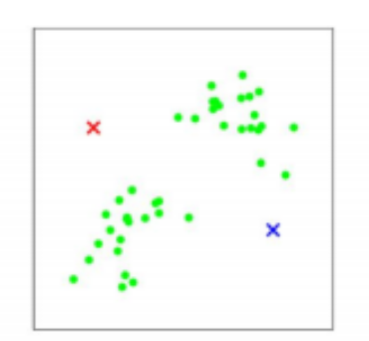
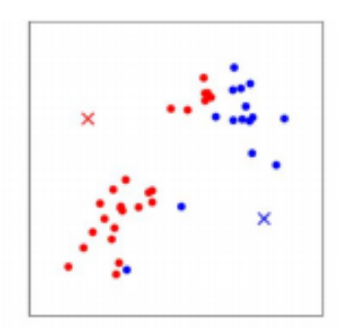
Clustering: K-means
Centroid 1
Dataset with two clusters. Centroids are randomly initialised
Cluster 1 is assigned to the closest data points to centroid 1
Cluster 2 is assigned to the closest data points to centroid 2
Centroid 2
Centroid 1
Centroid 2
Oscar Rondon

Slide 50
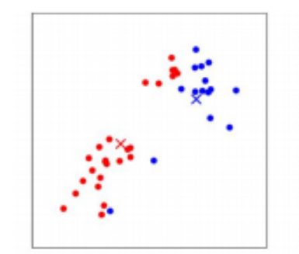

Clustering: K-means
Calculate the centroid of points in cluster 1 and cluster 2
Move centroid 1 and centroid 2 to these locations
Cluster 1 is assigned to the closest data points to centroid 1
Cluster 2 is assigned to the closest data points to centroid 2
Oscar Rondon

Slide 51

Clustering: K-means
Repeat until there are no more changes in the centroid locations
The centroids obtained are representative of the cluster of points and are used for further analysis
Centroid 2
Centroid 1
Oscar Rondon

Slide 52
Clustering: Hierarchical
Hierarchical clustering works using a measure of similarity between observations
The choice of the similarity measure depends on the problem
Data values start all in one cluster and splits are carried out recursively using different linkage criteria
The process is represented using a dendogram
The clusters are determined visually by analising the dendogram and using expert judment
Oscar Rondon

Slide 53

Clustering: Hierarchical
Example of a dendogram showing three clusters
Oscar Rondon

Slide 54

Clustering: Spectral
Spectral clustering is a more advanced technique for clustering
It is called ‘spectral’ because uses a spectral decomposition of a similarity matrix
The similarity between two observations $X$ and $Y$ is defined by the exponential function
$S\left(X,Y\right)=exp\left(−\frac{{\left\|X−Y\right\|}^{2}}{2σ^{2}}\right)$
The scaling parameter $σ^{2}$ controls how fast the similarity between the two points falls off with their distance
Oscar Rondon

Slide 55

Clustering: Spectral
The key idea of spectral clustering is to cluster the raw data using the eigenvectors of the similarity matrix
The first $k$ eigenvectors are used with $k$ the number of clusters
K-means approach is used with the eigenvectors in a slightly different way to the traditional k-means approach
Why not to use K-means on the raw data?
The eigenvectors tend to form tight clusters that are not evident in the raw data
Oscar Rondon

Slide 56



Clustering: Comparison
Raw data
Spectral clustering
K-means clustering
Oscar Rondon

Slide 57
Clustering
Open pm1_clustering.ipynb
and work through the exercises
Cericia Martinez & Guillaume Rongier | CSIRO

Slide 58
Partial Least Squares

Slide 59
A short introduction to PLS regression
PLS regression = Partial Least Squares regression
Its principle is similar to PCA regression, i.e., help with ill-conditioned multivariate problems
While PCA regression looks for uncorrelated components as a linear combination of the input variables only, PLS regression also tries to maximize the covariance between input and output variables
Especially useful when there are more variables than observations or multicollinearity between the input variables
Oscar Rondon

Slide 60
Exercise: The Octane dataset
Open pm2-PLS.ipynb
and go through the notebook
Cericia Martinez & Guillaume Rongier | CSIRO

Slide 61
Apply to your own Problem

Slide 62
If you don’t have a dataset
UCI Machine Learning Repository:
archive.ics.uci.edu/ml/index.php
Kaggle datasets:
www.kaggle.com/datasets
Cericia Martinez & Guillaume Rongier | CSIRO

Slide 63
Takeaways

Slide 64
High-level Takeaways From Today
Understand the differences between univariate and multivariate data and apply multivariate techniques and EDA.
Understand the basis of dimensionality reduction.
Execute measures of correlations.
Critique whether a correlation is spurious.
Identify if the process used in the activities is reproducible.
Understand the impact of missing data and recall practical solutions to work with incomplete data sets.
Cericia Martinez & Guillaume Rongier | CSIRO

Slide 65
High-level Takeaways From Today
Don’t forget to complete the day survey before you leave!
Cericia Martinez & Guillaume Rongier | CSIRO

